Slide 1

COPY MONITOR FOR CONSULTANTS MODELS
REVIT University
SHARING ELEMENTS BETWEEN DISCIPLINES
ORB UNIVERSITY – MAY 24, 2023
PRESENTED BY Christian Quintero

Slide 2
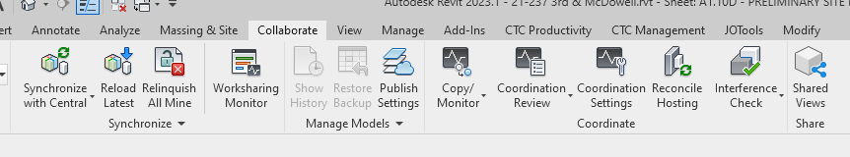
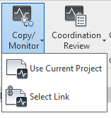
COPY / MONITOR
Copy/Monitor is a function in Revit that’s geared towards coordinating elements between disciplines.
Select Link : This function will let you pick from what model you are going to Copy or Monitor an element from

Slide 3
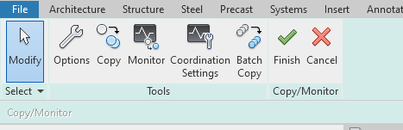
COPY / MONITOR – SELECT LINK
Once Select link is engaged it will let you pick any of the RVT_links within the project to interact with. At this point click on the consultant file.
Monitor will create a link between elements that will let you know if any parameter has changed on the “Monitored” Item. This can anything from length, position or even parameter values.

Slide 4
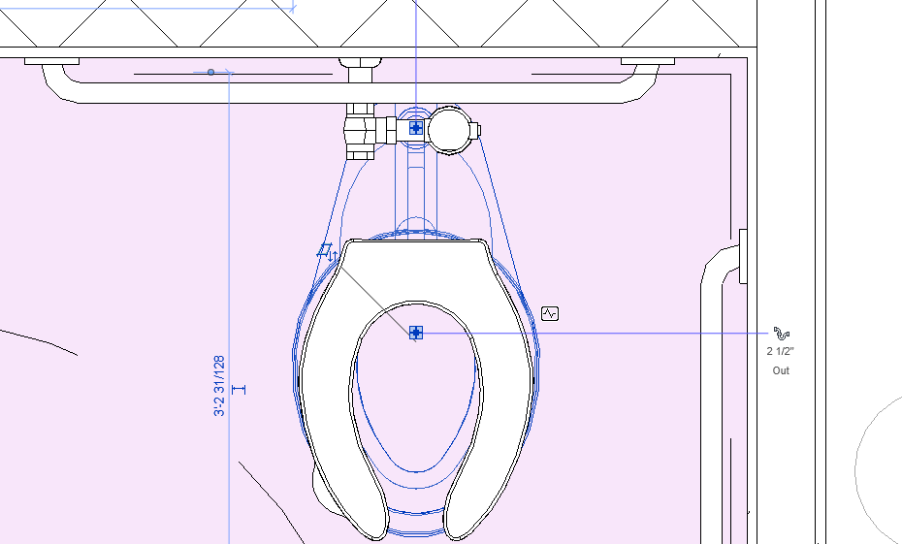

COPY / MONITOR – SELECT LINK
Monitored Elements will have an icon indicating that its being affected by this function.

Slide 5
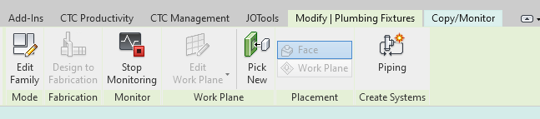
COPY / MONITOR – SELECT LINK
A Monitored Elements will also let you stop the command at anytime. This will sever the link between model elements. However, it will not delete any copies made on the model by the “copy” command in the copy/monitor tab.

Slide 6
COPY / MONITOR – SELECT LINK
Once Select link is engaged it will let you pick any of the RVT_links within the project to interact with. At this point click on the consultant file.
Copy will create an invisible link between the selected elements and our model, and make duplicate of the item into our Revit file. This new item and the Monitored item will be linked together, but don’t need to have the same type. This is especially useful for Architectural Categories such as: Levels, Grids, Columns, Walls, Floors. If the element is not one of these categories, it will copy a perfect duplicate of the family as presented on the consultant model.

Slide 7
COPY / MONITOR – SELECT LINK
Once Select link is engaged it will let you pick any of the RVT_links within the project to interact with. At this point click on the consultant file.
Batch Copy will let you do the same as copy without having to engage the command multiple times.

Slide 8
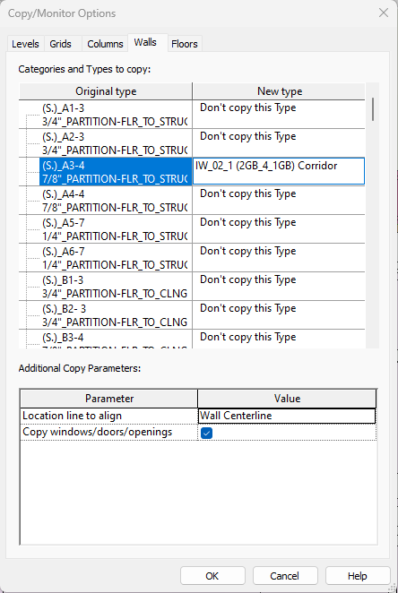
COPY / MONITOR – SELECT LINK
Once Select link is engaged it will let you pick any of the RVT_links within the project to interact with. At this point click on the consultant file.
Options will let you path copied elements into a specific category type.
These only apply to Levels, Grids, Columns, Walls, Floors.

Slide 9
COPY / MONITOR – SELECT LINK
Copy/Monitor Options will let you path a Category Type from the consultant file into one of our standard category types. This way every time you copy that specific ex Wall Type , then it will copy it as the standard wall we use for it. This will let you tag the element on our model, while keeping it connected
to the consultant model.
These are the consultant’s model category types.
These are our model category types within our Model

Slide 10
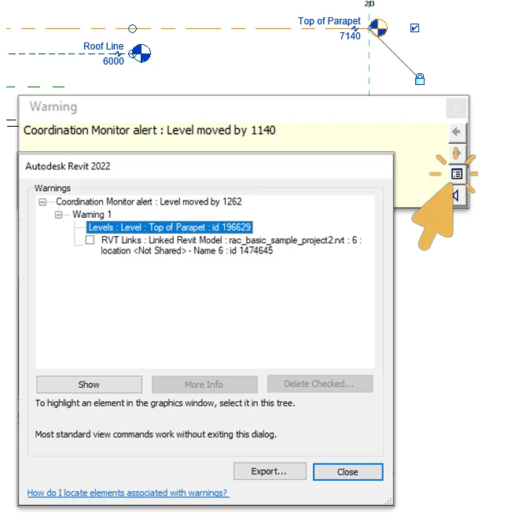
Coordination Review
When a monitored element is changed you will get a warning saying changes need to be resolved.

Slide 11
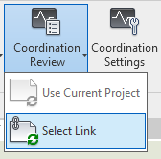
Coordination Review
If you missed the warning you can go to Coordination Review where all the changes made will be reflected.
Select Link : This function will let you pick from what model you are going to Copy or Monitor an element from

Slide 12
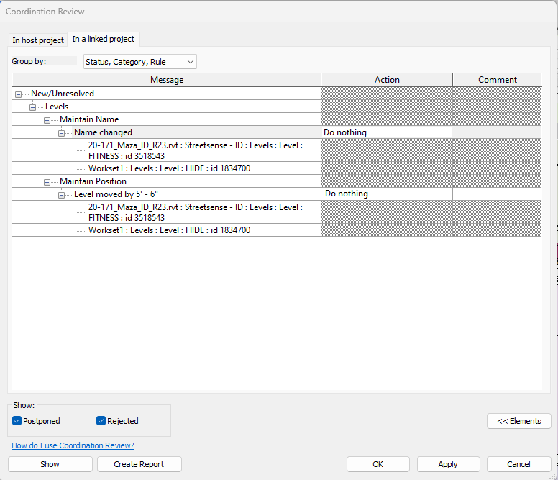
Coordination Review
Coordination Review is where all changes to monitored elements are reflected. You will get the option to Do Nothing, Accept or Denny changes. When accepted copied elements will automatically get modified to match the element its being monitored against.

Slide 13
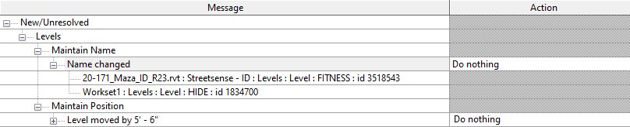

Coordination Review
Category
Changes

